Slide 1




NEXT GEN EMPLOYABILITY PROGRAM
Creating a future-ready workforce
Team Members
College Name
Student Name : S KAVYA PRIYA
Student ID : au511321104043
KINGSTON ENGINEERING COLLEGE

Slide 2

CAPSTONE PROJECT SHOWCASE
Project Title
Building Bus Reservation System using Python and Django
Abstract | Problem Statement | Project Overview | Proposed Solution | Technology Used | Modelling & Results | Conclusion

Slide 3
Abstract
The Bus Reservation System is a comprehensive software solution designed to streamline the process of booking and managing bus tickets for passengers and operators. In an increasingly digitized world, this system provides an efficient and user-friendly platform for passengers to book their bus tickets online, as well as for bus operators to manage their fleet and schedules seamlessly.
The system offers a range of features tailored to meet the needs of both passengers and operators. For passengers, it provides an intuitive interface where they can search for available buses, view schedules, select seats, make payments securely, and receive e-tickets instantly. Additionally, passengers can manage their bookings, make cancellations, and view their booking history conveniently through the system.
The Bus Reservation System aims to enhance the overall travel experience for passengers while improving efficiency and profitability for bus operators. By leveraging technology, automation, and data analytics, it brings convenience, reliability, and transparency to the bus ticketing process, ultimately contributing to the advancement of the transportation industry.
Source :

Slide 4
Problem Statement
Issue: The current bus ticket booking process is cumbersome and inefficient, leading to dissatisfaction among passengers and operational challenges for bus operators.
Challenges:
Inconvenient booking process: Long queues and reliance on third-party agents.
Limited information accessibility: Lack of real-time information on schedules, routes, and seat availability.
Booking management complexity: Difficulty in managing bookings, changes, and cancellations.
Operational inefficiencies: Manual processes leading to resource wastage and revenue loss for bus operators.
Source :

Slide 5
Project Overview
Need for Solution: A modernized Bus Reservation System is essential to streamline booking processes, enhance user experience, and optimize bus operations.
Solution Objectives:
Provide a user-friendly platform for convenient online booking.
Offer real-time updates on bus schedules, routes, and seat availability.
Simplify booking management with easy modification and cancellation options.
Improve operational efficiency for bus operators through automation and analytics.
Expected Outcome: The Bus Reservation System aims to revolutionize the bus ticketing experience, making it more efficient, accessible, and user-centric for passengers while enhancing operational effectiveness for bus operators.
Source :

Slide 6
Proposed Solution
The proposed solution for the Bus Reservation System aims to revolutionize the current inefficiencies prevalent in the bus ticketing process. By developing a modernized platform, the system intends to provide passengers with a seamless and user-friendly interface for booking bus tickets conveniently. Real-time information on bus schedules, routes, seat availability, and fares will be readily accessible to users, ensuring informed decision-making. Additionally, robust booking management tools will empower passengers to effortlessly manage their bookings, make changes, cancellations, and refunds as needed. For bus operators, the system will offer administrative tools for efficient ticket management, scheduling, and analytics, thereby enhancing operational efficiency and revenue generation. Ultimately, the Bus Reservation System seeks to improve user satisfaction, reduce manual errors, and optimize resource allocation, fostering a more efficient and user-centric bus ticketing experience for all stakeholders involved.
Source :

Slide 7
Key Features:
User-Friendly Interface: Provide an intuitive platform for passengers to search, select, and book bus tickets conveniently.
Real-Time Information: Offer up-to-date information on bus schedules, routes, seat availability, and fares to users.
Booking Management Tools: Enable passengers to easily manage bookings, make changes, cancellations, and refunds.
Operational Optimization: Provide bus operators with administrative tools for efficient ticket management, scheduling, and analytics.
Source :

Slide 8
Expected Benefits:
Enhanced User Experience: Passengers will benefit from a streamlined booking process, real-time information availability, and user-friendly interfaces, leading to greater satisfaction and convenience.
Operational Efficiency: Bus operators will experience improved efficiency in ticket management, scheduling, and resource allocation, resulting in reduced overhead costs and increased profitability.
Reduced Errors and Wastage: Automation of manual processes and data-driven decision-making will minimize errors and resource wastage, leading to a more reliable and sustainable operation.
Increased Revenue: By optimizing seat utilization and offering dynamic pricing options, bus operators can maximize revenue generation and capitalize on demand fluctuations.
Improved Transparency: The system will enhance transparency by providing clear information on schedules, fares, and availability, fostering trust and confidence among passengers.
Adaptability and Scalability: With a scalable architecture and adaptable features, the system can accommodate growth and evolving user needs, ensuring long-term viability and relevance in the market.
Environmental Impact: By encouraging online bookings and reducing paper-based processes, the system contributes to environmental sustainability by minimizing carbon footprint and waste production.
Source :

Slide 9


Technology Used
Front-end
Back-end
Source :

Slide 10
Modelling & Results
The Bus Reservation System is meticulously designed through systematic modeling techniques, including UML diagrams for visualizing system components and database design through entity-relationship diagrams (ERDs). These models guide the development process, ensuring clarity in system requirements and efficient data management. The software development phase employs agile methodologies and modern programming languages like Python or Java, facilitated by frameworks such as Django or Spring Boot.
Following development, rigorous user testing, including user acceptance testing (UAT) and usability testing, validates system functionality and user experience. Performance evaluations ascertain the system's responsiveness, scalability, and reliability under various loads, optimizing performance for peak usage. Upon deployment, evaluation metrics such as user satisfaction, booking efficiency, and revenue generation are monitored closely. Continuous improvement cycles based on user feedback and technological advancements drive iterative updates and enhancements, ensuring the Bus Reservation System remains adaptable and competitive in the evolving landscape of transportation services.
Source :

Slide 11
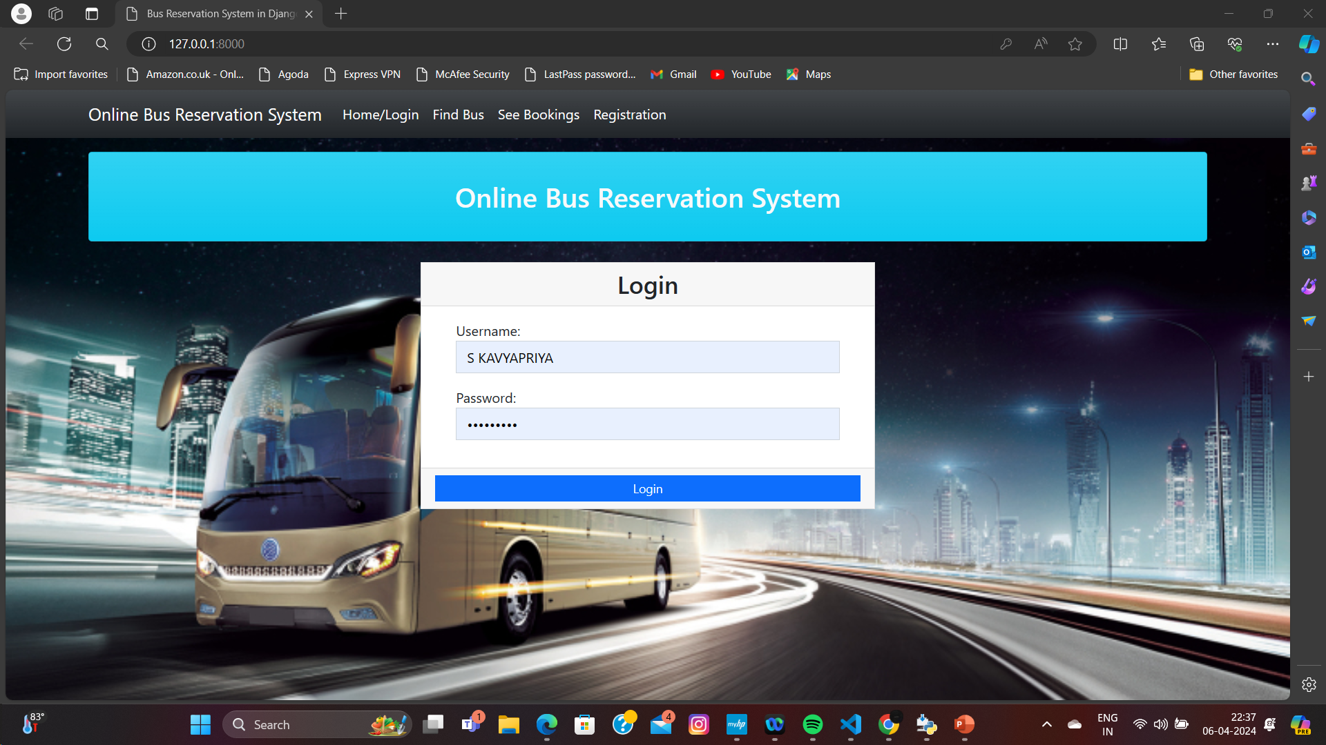
Homepage

Slide 12
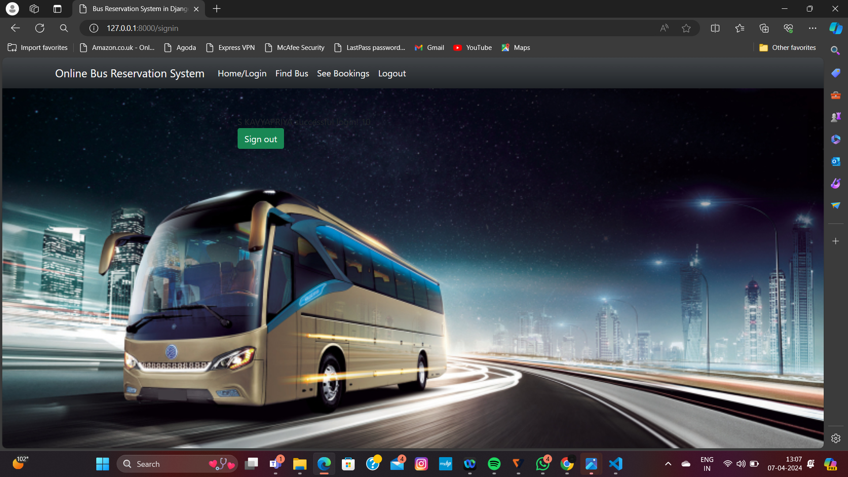
About-Us-Page

Slide 13
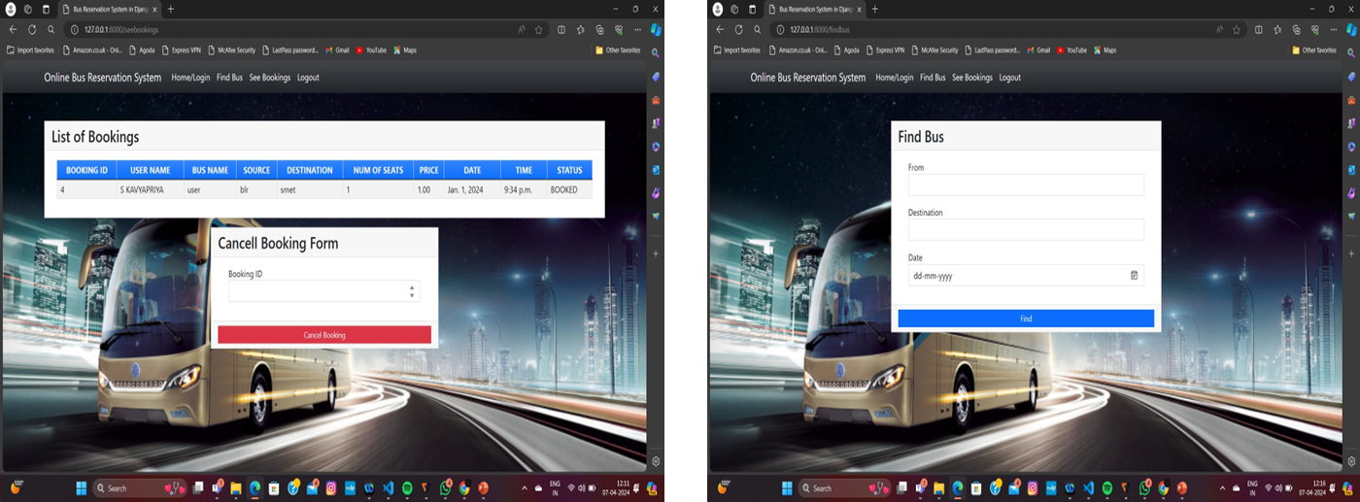
Service-Page

Slide 14
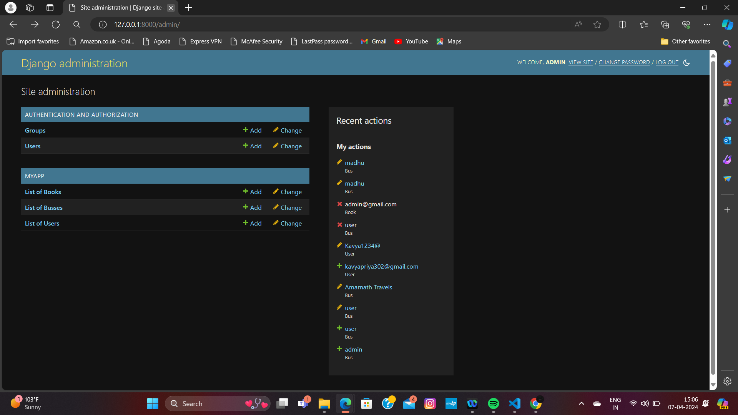
Departments-Page

Slide 15
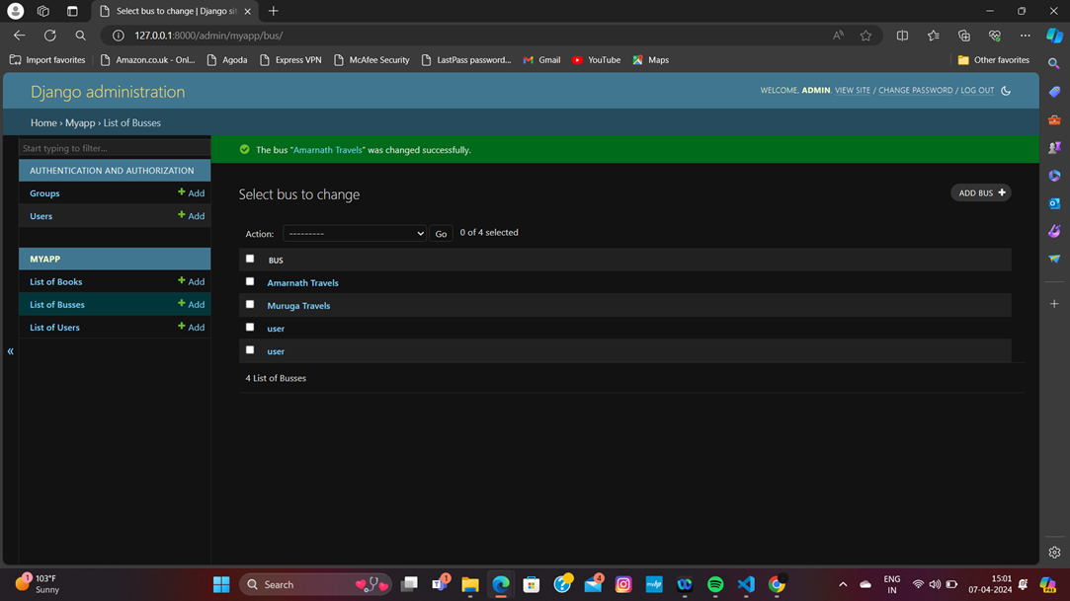
Blog-Page

Slide 16
Future Enhancements:
FUTURE ENHANCEMENTS OF A BUS RESERVATION SYSTEM PROJECT:
Mobile App Development
Integration with GPS Tracking
Dynamic Pricing
Feedback and Rating System
Integration with Other Transportation Modes
Language Localization
Enhanced Security Features
Predictive Analytics

Slide 17
Conclusion
The development of the bus reservation system has been successfully completed, providing a user-friendly platform for booking bus tickets efficiently. Through this project, we have achieved the goals of streamlining the ticketing process, enhancing customer satisfaction, and improving overall operational efficiency for bus companies. The system's features, including real-time availability updates, secure payment processing, and user-friendly interface, have been thoroughly tested and implemented to ensure a seamless booking experience. Moving forward, ongoing maintenance and updates will be essential to keep the system robust and adaptable to future needs. Overall, the bus reservation system project has been a significant step towards modernizing bus ticketing services, benefiting both passengers and service providers alike.
Source :

Slide 18
Thank You!
Notes:
Thank You !!

